Slide 1


Data Analysis Techniques 890F3
The Normal Distribution & Hypothesis Tests

Slide 2


Feedback
💜 Thank you very much 💜 to the students who have reached out to me and Tom via email and/or in my office hours.
I have updated the canvas pages for Module Information and Assignments & Guidance - I think they are clearer now.
I have added a section for Technical Support to the canvas page, with some links to videos and pages and some FAQs.
I am trying to find a second office hour slot that works for all- please indicate your availability if you cannot make Tuesday 12-1 and have not yet filled the when2meet.

Slide 3
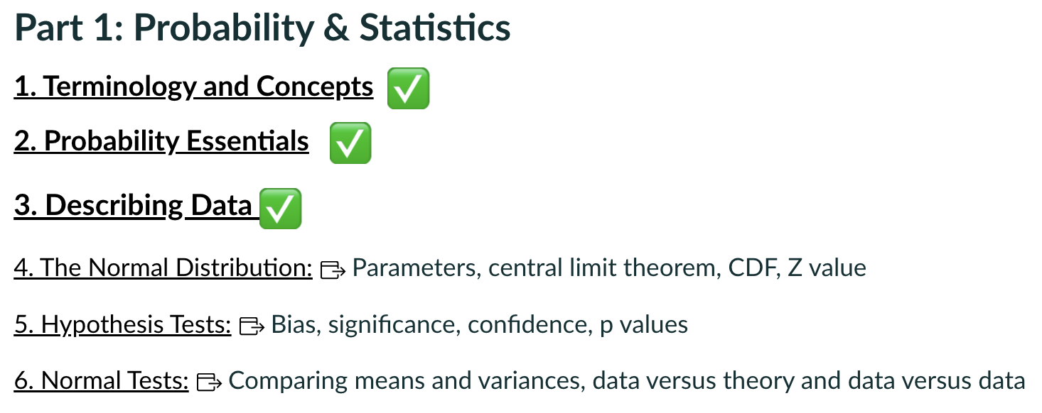
Where we are
Today

Slide 4
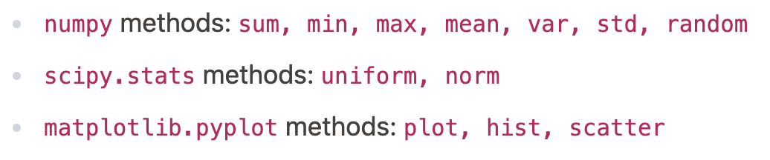
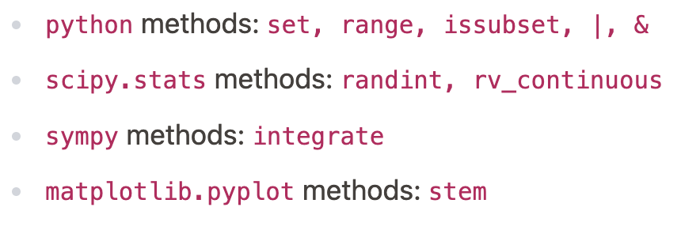
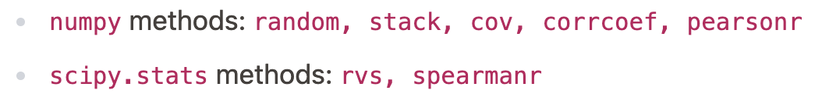
Tools introduced in sections 1 - 3
Find your own pace.
New to python: you will get lots of practice this term.
Experienced and expert: focus on an area you are not expert in.

Slide 5
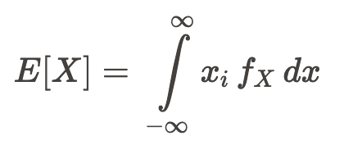




Recap Describing Data
We focused on:
True Expectation and Variance
Covariance and Linear Correlations
Uncertainty Propagation
or

Slide 6
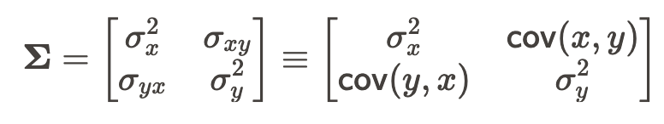
Recap Describing Data
Covariance Matrix aka “Error Matrix”
We focused on:
True Expectation and Variance
Covariance and Linear Correlations
Uncertainty Propagation
This is our “box of uncertainties”.
The diagonal has the (squared) uncertainties on the RVs.
The corner has the covariance between the RVs

Slide 7
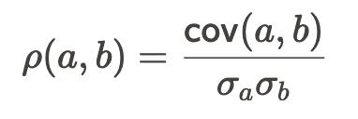
Recap Describing Data
Covariance Matrix aka “Error Matrix”
We focused on:
True Expectation and Variance
Covariance and Linear Correlations
Uncertainty Propagation
Linear Correlation Coefficient
The linear correlation coefficient only tells us about linear correlations.
Apparently unrelated datasets can have spuriously high linear correlation coefficients (Workshop 3).

Slide 8



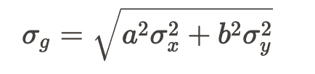

Recap Describing Data
General function h:
We focused on:
True Expectation and Variance
Covariance and Linear Correlations
Uncertainty Propagation
Jacobian matrix has Nfuncs rows and Nrvs columns.
Nfuncs=1 for linear functions
If X,Y are independent:
“Sum in quadrature”
You can of course look up useful uncertainty propagation formulae on eg wikipedia or in a text book.

Slide 9
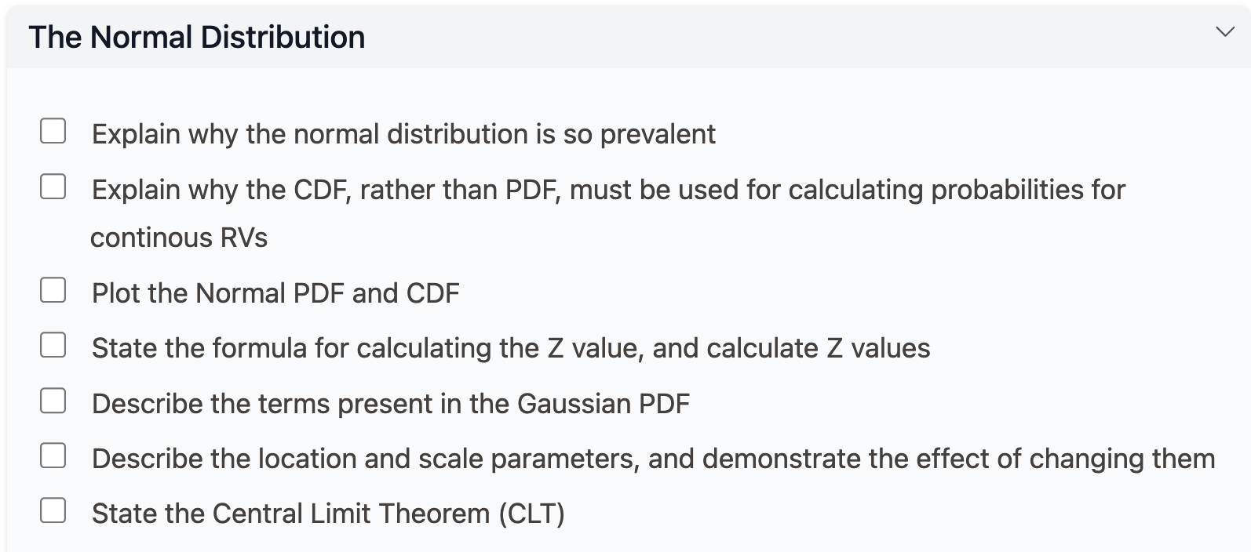
The Normal Distribution

Slide 10
Focus: The Normal Distribution
The Normal (Gaussian) PDF
Parameters
Infinite range, the log scale, log rules
The Central Limit Theorem (CLT) versus the Law of Large Numbers (LLN)

Slide 11

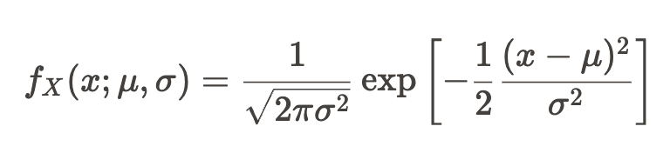
The Normal (Gaussian) PDF
“The Continuous RV X is Normally Distributed”
The Probability Density Function (PDF) is:

Slide 12
The Normal (Gaussian) PDF
“The Continuous RV X is Normally Distributed”
The Probability Density Function (PDF) is:
The Random Variable (RV) is x.

Slide 13
The Normal (Gaussian) PDF
“The Continuous RV X is Normally Distributed”
The Probability Density Function (PDF)
The parameters are 𝜇 (“mu”: the mean) and σ (“sigma”: the standard deviation).

Slide 14
The Normal (Gaussian) PDF
“The Continuous RV X is Normally Distributed”
The Probability Density Function (PDF)
The constant term is just a number. If we know σ, we know the number.

Slide 15
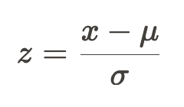
The Normal (Gaussian) PDF
“The Continuous RV X is Normally Distributed”
The Probability Density Function (PDF)
The exp is the exponential function. The thing in the square brackets is the argument of the exponential function .
Can define the Standard Normal Random Variable (Z value) :

Slide 16
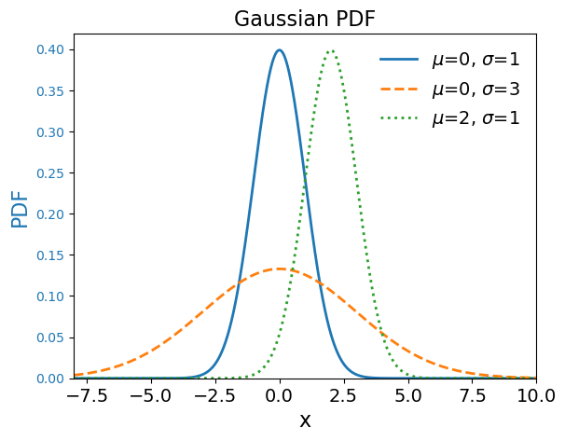
Gaussian Parameters
The “location” parameter 𝜇 controls the central value of the distribution.
The “scale” parameter σ controls the spread of the distribution.

Slide 17
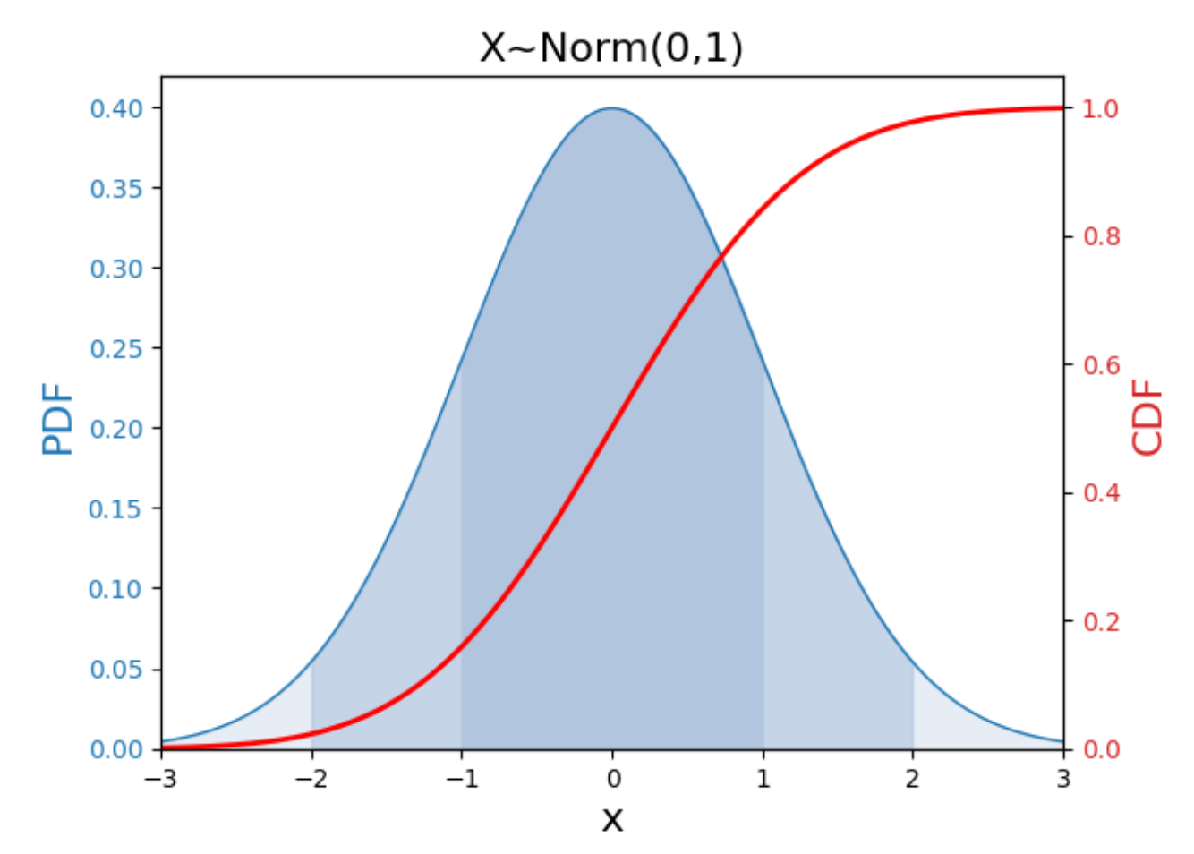
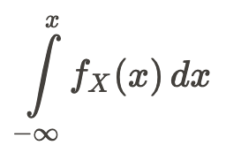
Gaussian Probabilities
Because the Normal distribution is continuous, the probabilities are calculated using the Cumulative Distribution Function (CDF).
The CDF is the probability of finding a value less than or equal to x: P( X ≤ x).
BUT we can’t do this integral. It has no analytical solution.

Slide 18
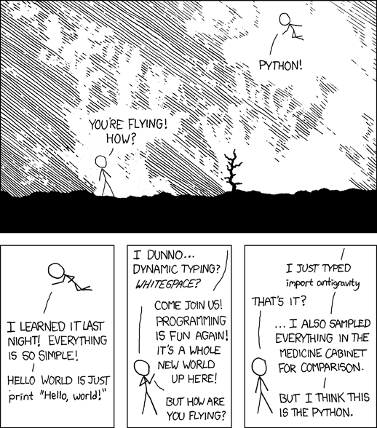
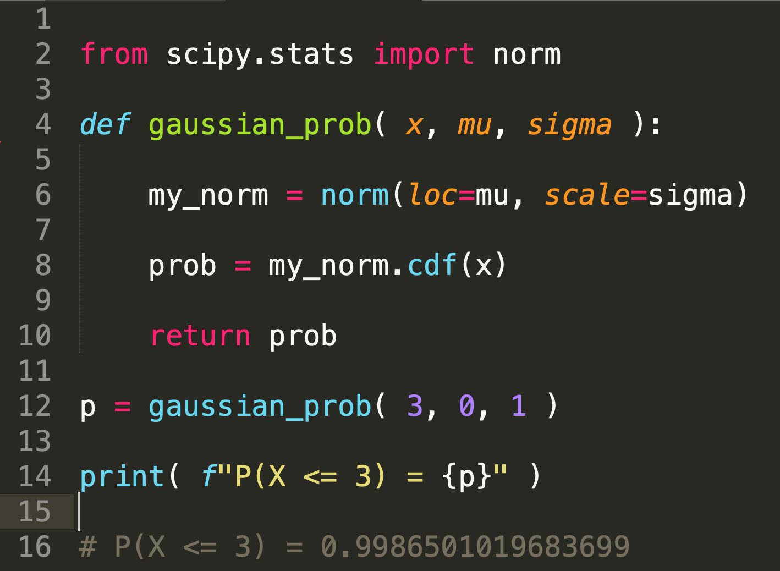
Gaussian Probabilities
We used to use “look-up tables” to calculate Gaussian probabilities.
Luckily, we now have python libraries!
My preferred text editor: Sublime Text
https://xkcd.com/353/

Slide 19
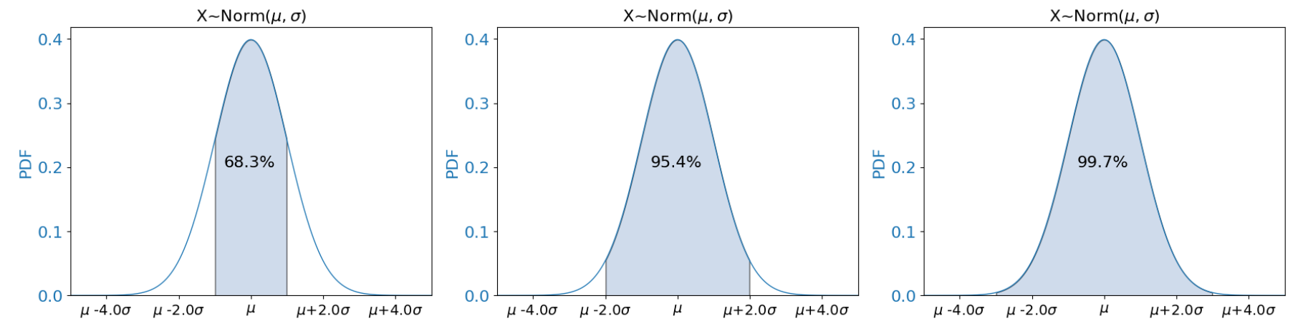
Gaussian Probabilities
For any values of the parameters 𝜇 and σ, the “68-95-99.7 rule” is satisfied.
These are the percentages of the area under the PDF within +/- 1-2-3 standard deviations (σ) of the mean.

Slide 20
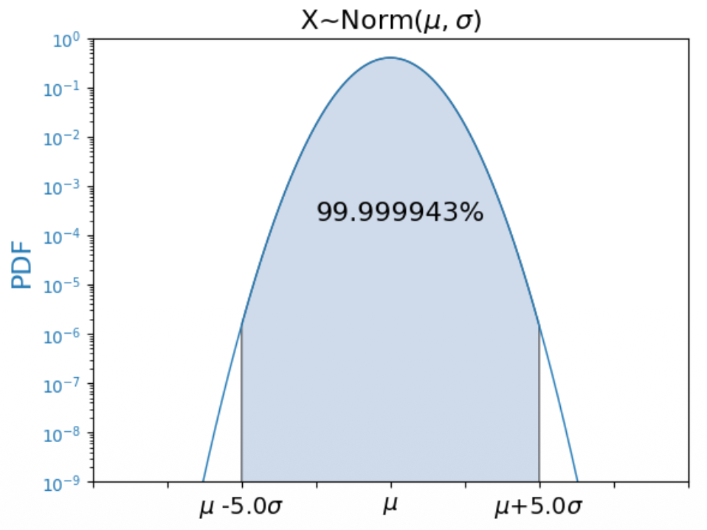
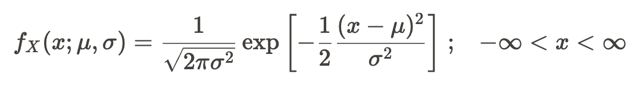
Infinite Range
y-axis is log scale
+/- 5σ covers ~99.999943% of the area under the PDF. This is Confidence Level for the 5σ Confidence Interval.
This means that I would expect to measure a value outside this range once in ~1.75M repeated experiments.
There is no value of X with zero probability, because the Gaussian PDF has infinite support.

Slide 21



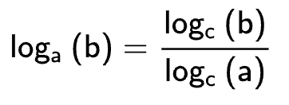
Log Rules
Log is reverse operation to exponentiation.
Log of quotient => difference of logs
Log of product => sum of logs
Change of base: eg base 10 for “normal counting”, base 2 for binary, base e for the natural log “ln” (default for np.log)
See full revision here or the HELM workbook here

Slide 22
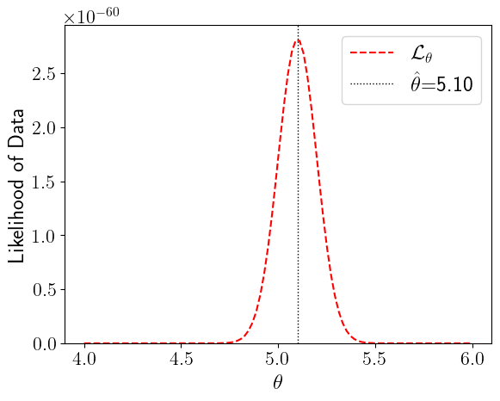
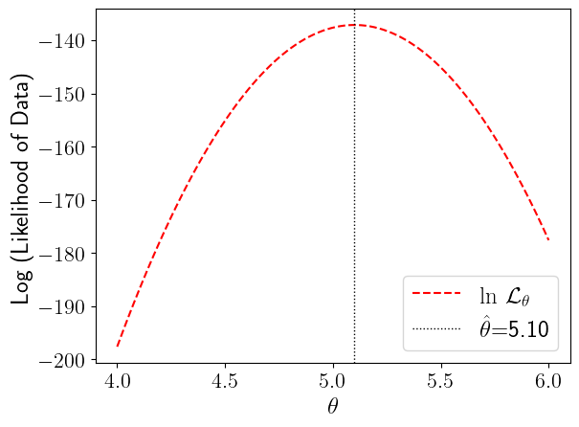

Why Logs?
Very useful for exploratory plots of data!
Normal dist. is infinite in range, but we can’t see anything in the tails.
Log Normal is parabolic (-x² see why): can see into the tails.
Note that ln(p) <0 for 0<p<1: log probability is always negative

Slide 23
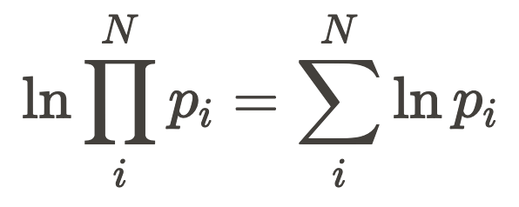
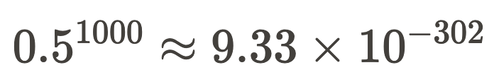
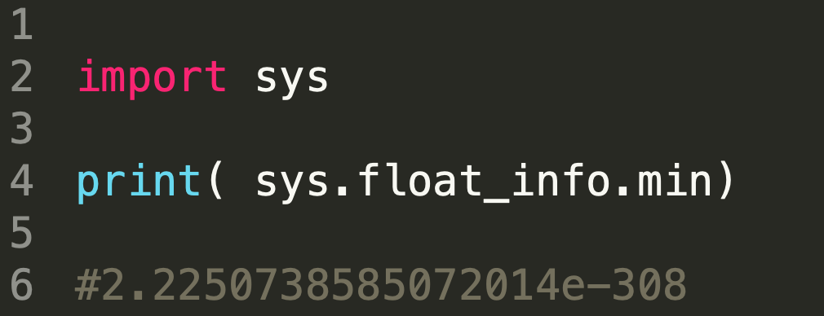
Why Logs?
Essential for numerical computations
Consider 1000 measurements. Each one has a probability between 0 and 1. Say, 0.5, for the sake of example.
The product of these probabilities is
This is close to the limit of the smallest number your computer can compute.
The sum of the logs by-passes this issue.

Slide 24
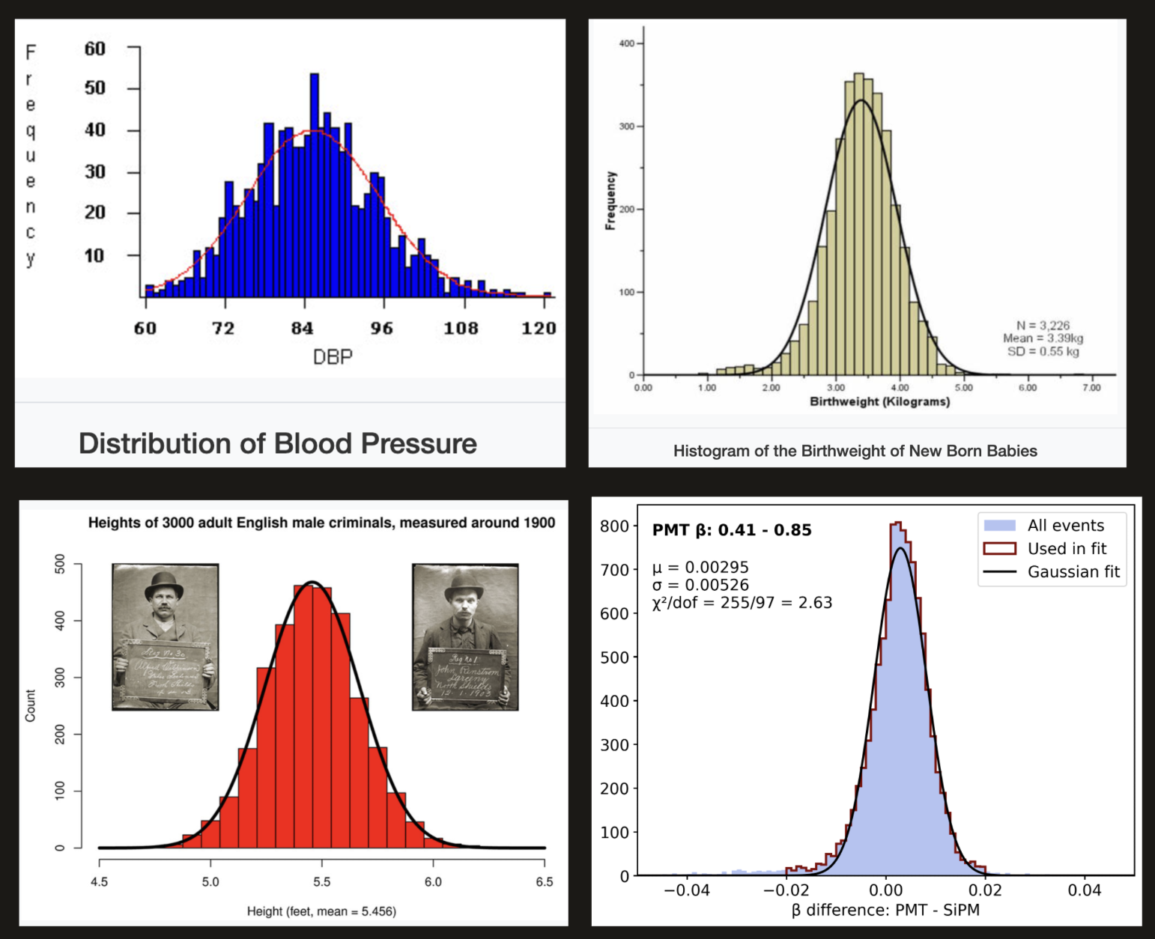
The Normal (Gaussian) Distribution
So many things are normally distributed. Heights, weights, blood pressures, measured proton speeds, IQs, electronic noise, and experimental uncertainties.
These things are not physically alike, but they are mathematically alike, because they are combinations (sums, means) of many factors.
For those with an interest in the math: Nice blog explaining Gauss’s process

Slide 25
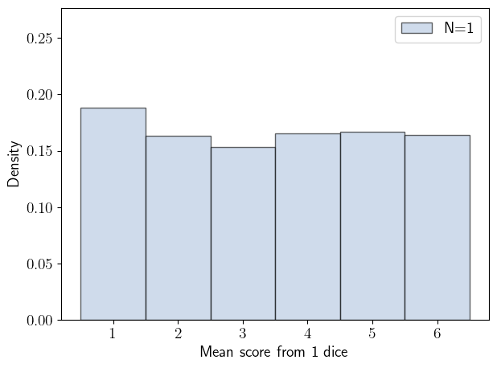
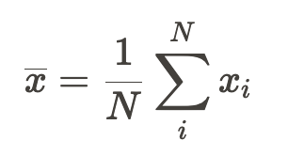
Central Limit Theorem
The sums / means of RVs from any underlying probability distribution tend towards a normal distribution as the sample size N approaches infinity.
I calculate one mean from a sample of size N
N=1 roll of the dice, I score 2. The mean is 2. If I keep repeating this, I will get a uniform distribution [1,6]. The number of repetitions is not the sample size, but needs to be large enough for a distribution to reveal itself if I want a visual. Rule of thumb is at least 30 data points (means). I used 1000 for these plots.

Slide 26
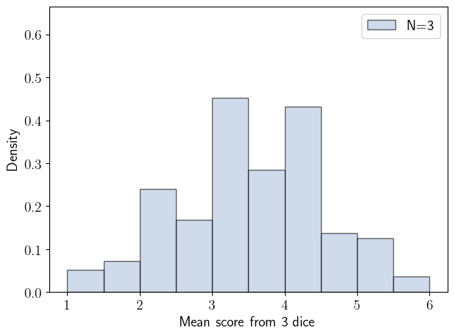
Central Limit Theorem
The sums / means of RVs from any underlying probability distribution tend towards a normal distribution as the sample size N approaches infinity.
I calculate one mean from a sample of size N
N=3 rolls of the dice, I find eg 3,2,6, the mean is (3+2+6)/3 ≈ 3.67. Repeat a bunch of times. there will be more values close to the central value and fewer in the tails (only one way to achieve a mean of 1, 6 for example)

Slide 27
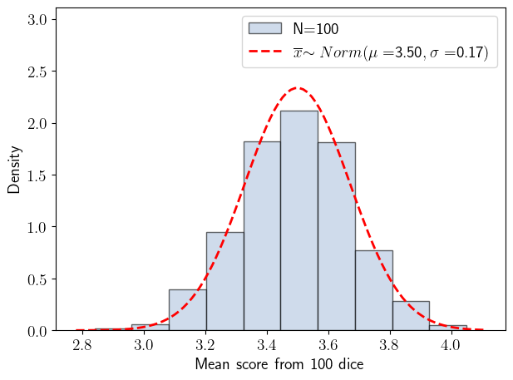
Central Limit Theorem
The more dice I roll to calculate the mean (higher N), the smoother and more centrally focused my distribution becomes.
In this example with N=100 dice, the distribution of means resembles a Normal distribution with 𝜇 =3.5 and σ=0.17

Slide 28
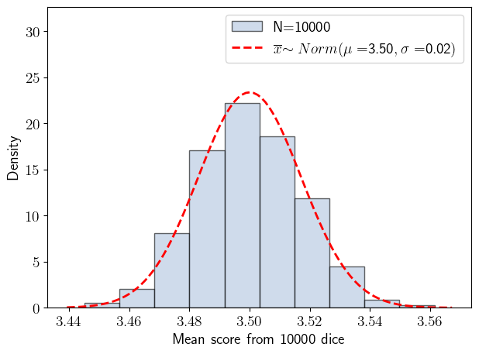
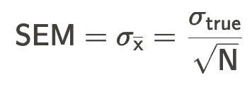
Central Limit Theorem
In this example with 10,000 dice, the distribution of means resembles a Normal distribution with 𝜇 =3.5 and σ=0.02
The distribution of means is approaching a Central Limit equal to the expectation 𝜇 =3.5.
The width of the distribution is shrinking as

Slide 29
CLT versus LLN
The Law of Large Numbers (LLN) tells us that if we were to increase the size of the data sample to infinity the sample mean would approach the true mean with high probability. This relates the mean value of a data distribution to the mean of the true underlying distribution. N is the number of measurements in the distribution. This is not specific to the Normal distribution.
The Central Limit Theorem (CLT) tells us that the distribution of means calculated from N samples approaches a normal distribution as N approaches infinity. This relates the distribution of the means to a normal distribution. N is the number of samples used to calculate the means in the distribution.

Slide 30
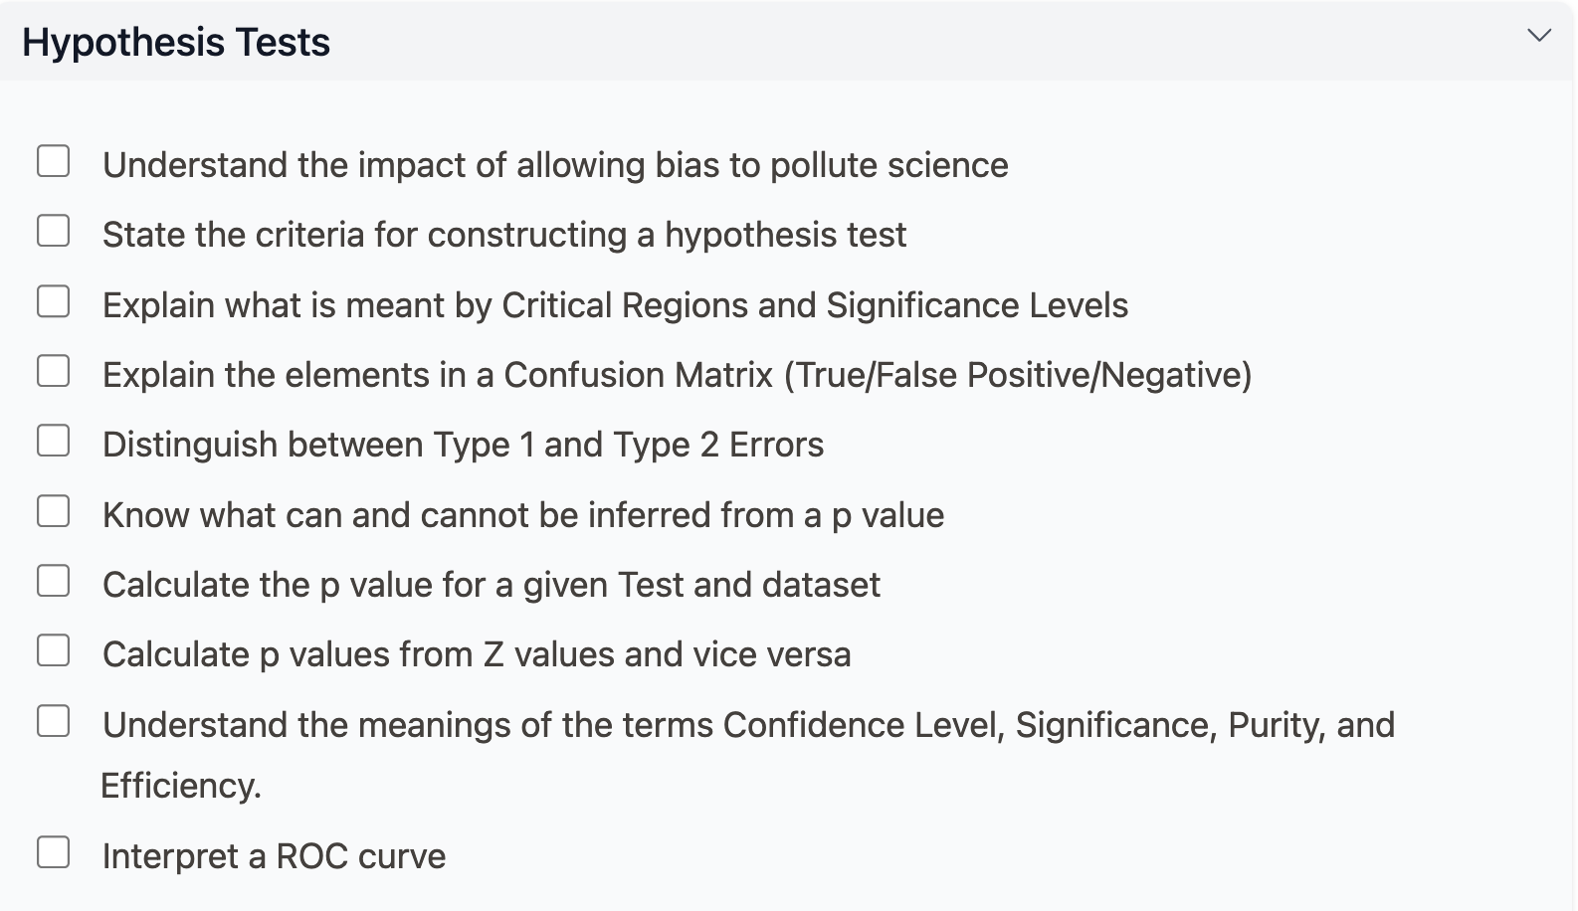
Hypothesis Tests

Slide 31
Focus: Hypothesis Tests
Designing a test
Terminology
What a p value is and is not

Slide 32
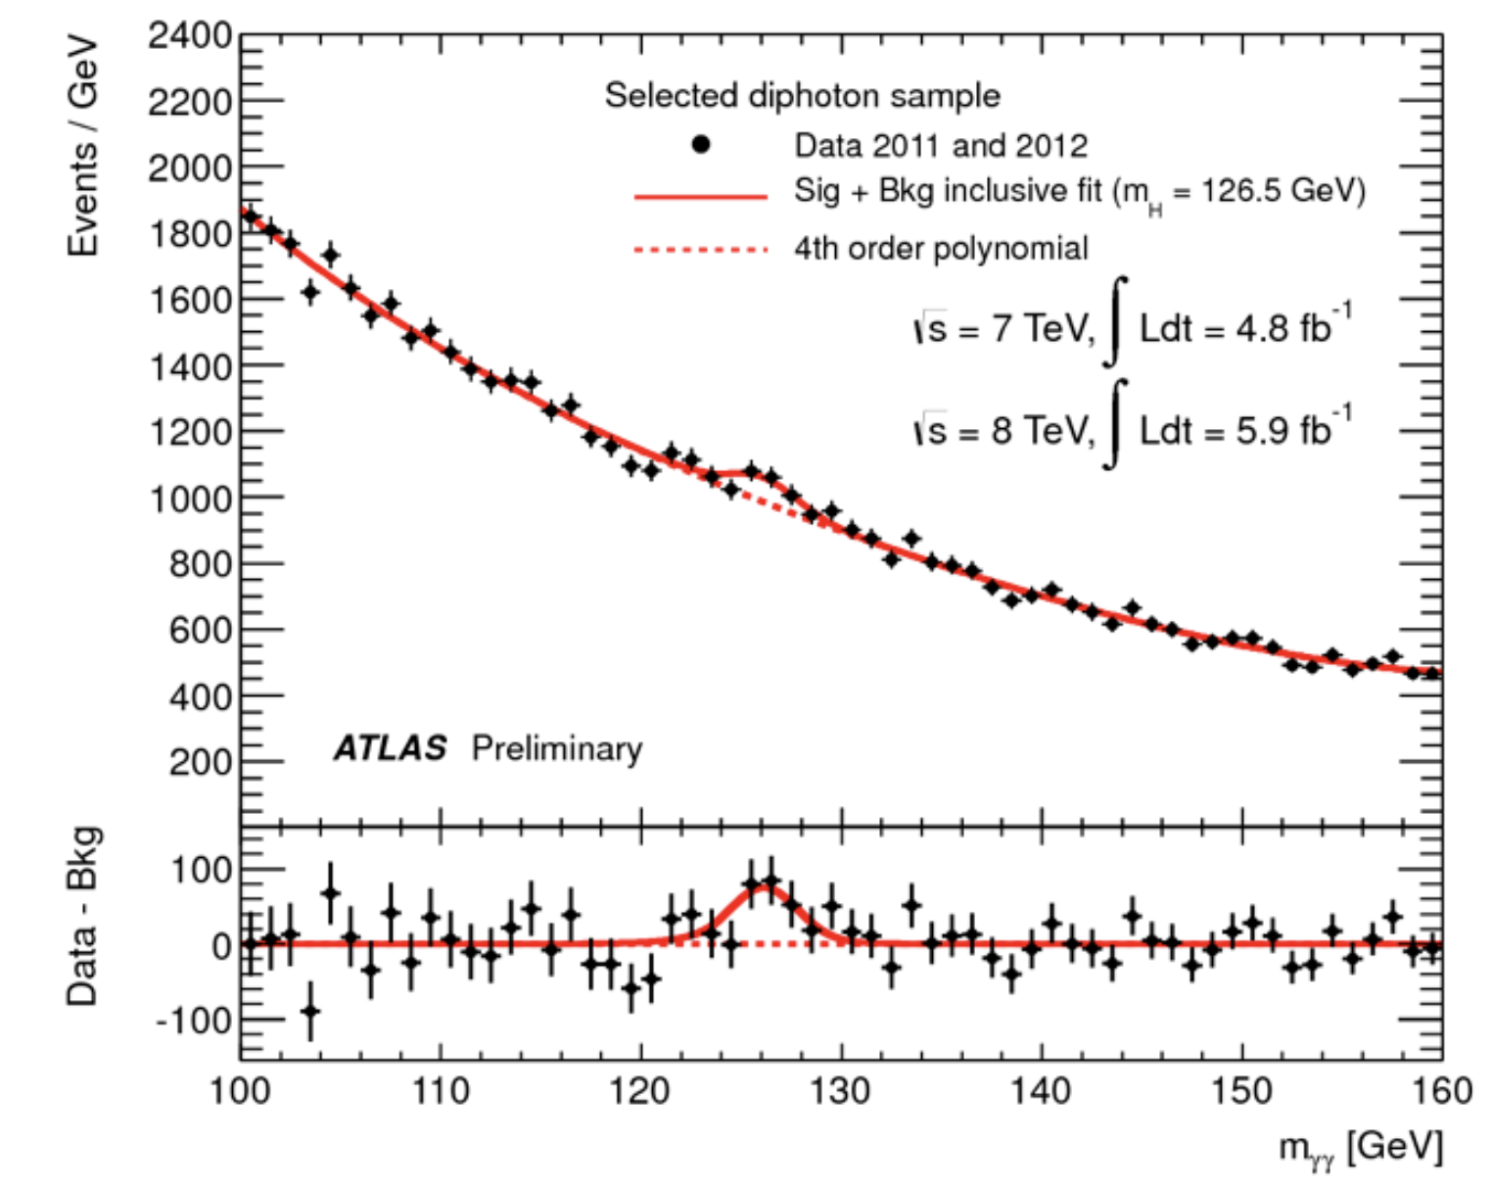


The Null and Alternative Hypothesis
“Nothing to see here”
“Higgs Boson!”

Slide 33
How to test a hypothesis
Before looking at your data, define a Critical Region using a Significance Level α .
The smaller α is, the less likely you are to get a dreaded “Type 1 error”, in which you claim to have rejected the Null Hypothesis but are wrong. Many people (eg medics) use α = 5% (random chance of a Type 1 error is 1 in 20), particle physicists use “5𝝈” (α ≅ 0.00006%, chance of a Type 1 error is 1 in 1.7M).
Why don’t medics use a smaller α, and find out their published claims are wrong less often?
The Significance Level defines the Critical Region: a region where the Null Hypothesis has low probability (α). Aim of the game is to define this region such that the alternative hypothesis distribution is not decimated!

Slide 34
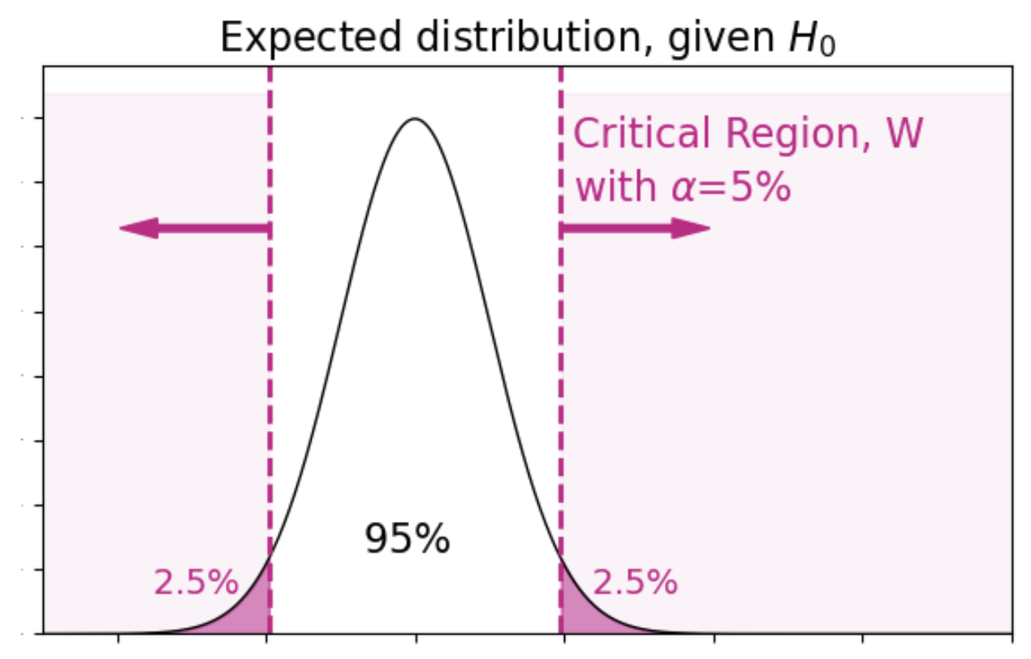
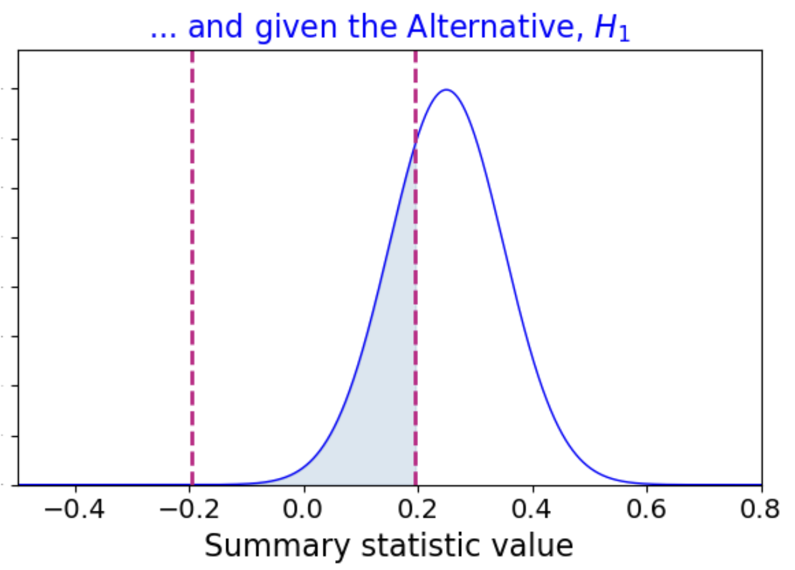
Critical Region
Easiest to visualise in 1D - but critical regions are usually multi-dimensional.
Choosing a small significance level α reduces the chance of a type 1 error (good!), but also reduces the “power” of the test in terms of the alternative hypothesis (bad).
This is because the null and alternative distributions (always) overlap.
Designing an optimal critical region (choosing selection cuts) is a lot of work.

Slide 35
Purity and Efficiency
If you have loads of data (particle physics) you can push α to very small values, ensuring a high-purity critical region (pure: very little null hypothesis in there). This is because you can still expect to see some alternative hypothesis events*.
If you are “statistically limited” (small dataset) you will be focusing on high efficiency for the alternative hypothesis, which means larger α.
*if the alternative hypothesis is the underlying truth!

Slide 36
Focus: Hypothesis Tests
Designing a test
Terminology : So. Many. Words (and acronyms)
What a p value is and is not

Slide 37
Data Labels and Truth Labels
Count the intersections between the two possible data labels and the two possible truth labels. The total sample size is N_{s}.
Data Labels
{
 | a | a’ | Truth Totals
A | N( A ∩ a) | N( A ∩ a’) | N(A)
A’ | N( A’ ∩ a) | N( A’ ∩ a’) | N(A’)
Data Totals | N(a) | N(a’) | N_{s}
{
Truth Labels

Slide 38
True/False Positive/Negative Rates
“True”: The Data Label matches the Truth Label (“true” → “correct”)
Data Labels
{
 | a | a’ | Truth Totals
A | N( A ∩ a) | N( A ∩ a’) | N(A)
A’ | N( A’ ∩ a) | N( A’ ∩ a’) | N(A’)
Data Totals | N(a) | N(a’) | N_{s}
{
Truth Labels

Slide 39
True/False Positive/Negative Rates
“False”: The Data Label does not match the Truth Label (“false” → “incorrect”)
Data Labels
{
 | a | a’ | Truth Totals
A | N( A ∩ a) | N( A ∩ a’) | N(A)
A’ | N( A’ ∩ a) | N( A’ ∩ a’) | N(A’)
Data Totals | N(a) | N(a’) | N_{s}
{
Truth Labels

Slide 40
True/False Positive/Negative Rates
The Data Label indicates a positive result (a) or a negative result (a’)
Data Labels
{
 | a=positive | a’=negative | Truth Totals
A | N( A ∩ a) | N( A ∩ a’) | N(A)
A’ | N( A’ ∩ a) | N( A’ ∩ a’) | N(A’)
Data Totals | N(a) | N(a’) | N_{s}
{
Truth Labels

Slide 41
True/False Positive/Negative Rates
The Data Label indicates a positive result (a) or a negative result (a’)
Data Labels
{
 | a=positive | a’=negative | Truth Totals
A | TP | FN | TP+FN
A’ | FP | TN | FP+TN
Data Totals | Positive | Negative | N_{s}
{
Truth Labels

Slide 42
My Opinion
This area of statistics does not have to be anywhere near as complicated and confusing as it most people present it.
I want to know two things:
Did my labelling catch most of the true events of interest? “Efficiency”
What fraction of my dataset is correctly labelled? “Purity”
1 : Efficiency = N correct / N truth
2 : Purity = N correct / N data

Slide 43
Simple versus Confusing
I want to know two things:
Did my labelling catch most of the true events of interest? “Efficiency”
What fraction of my dataset is correctly labelled? “Purity”
1 : Efficiency = N correct / N truth
2 : Purity = N correct / N data
TPR = TP / (TP+FN) = Sensitivity =
N correct (positive) / N truth (positive)
TNR = TN / (FP+TN) = Specificity =
N correct (negative) / N truth (negative)
Efficiency is TPR or TNR, depending on the truth label in our denominator.

Slide 44
Simple versus Confusing
I want to know two things:
Did my labelling catch most of the true events of interest? “Efficiency”
What fraction of my dataset is correctly labelled? “Purity”
1 : Efficiency = N correct / N truth
2 : Purity = N correct / N data
TP / (TP + FP) = Positive Predictive Value = N correct (positive) / N data (positive)
TN / (TN + FN) = Negative Predictive Value = N correct (negative) / N data (negative)
Purity is 1-FPR or 1-FNR, depending on the data label in our denominator.

Slide 45
True Positive Rate (Efficiency, Sensitivity)
“True Positive Rate” TPR = TP / (TP+FN) : fraction of truth label with correct data label
Note: TPR + FNR = (TP+FN) / (TP+FN) = 1
I am interested in this truth label
 | a=positive | a’=negative | Truth Totals
A | TP | FN | TP+FN
A’ | FP | TN | FP+TN
Data Totals | Positive | Negative | N_{s}
The number I labelled correctly in data.
The total number with this truth label

Slide 46
True Positive Rate
“True Positive Rate” TPR = TP / (TP+FN) : fraction of truth label with correct data label
 | a=positive | a’=negative | Truth Totals
A | TP | FN | TP+FN
A’ | FP | TN | FP+TN
Data Totals | Positive | Negative | N_{s}
Example 1: TPR is the probability of someone testing positive (data label a) for a disease, given they have the disease (truth label A).

Slide 47
True Positive Rate
“True Positive Rate” TPR = TP / (TP+FN) : fraction of truth label with correct data label
 | a=positive | a’=negative | Truth Totals
A | TP | FN | TP+FN
A’ | FP | TN | FP+TN
Data Totals | Positive | Negative | N_{s}
Example 2: TPR is the probability of categorising a robot as a designed by Alf (data label a), given that it is indeed designed by Alf (truth label A).

Slide 48
True Negative Rate (Efficiency, Specificity)
“True Negative Rate” TNR = TN / (FP+TN) : fraction of truth label with correct data label
Note: TNR + FPR = (TN+FP) / (FP+TN) = 1
 | a=positive | a’=negative | Truth Totals
A | TP | FN | TP+FN
A’ | FP | TN | FP+TN
Data Totals | Positive | Negative | N_{s}
I am interested in this truth label
The number I labelled incorrectly in data.
The total number with this truth label

Slide 49
True Negative Rate
“True Negative Rate” TNR = TN / (FP+TN) : fraction of truth label with correct data label
Note: TNR + FPR = (TN+FP) / (FP+TN) = 1
 | a=positive | a’=negative | Truth Totals
A | TP | FN | TP+FN
A’ | FP | TN | FP+TN
Data Totals | Positive | Negative | N_{s}
I am interested in this truth label
Example 1: TNR is the probability of someone testing negative (data label a’) for a disease, given they do not have the disease (truth label A’).

Slide 50
Purity
What fraction of my dataset is correctly labelled?
Purity of sample labelled positive = TP / (TP+FP)
 | a=positive | a’=negative | Truth Totals
A | TP | FN | TP+FN
A’ | FP | TN | FP+TN
Data Totals | Positive | Negative | N_{s}
I am interested in this data label

Slide 51
Purity
What fraction of my dataset is correctly labelled?
Purity of sample labelled negative= TN / (TN+FN)
 | a=positive | a’=negative | Truth Totals
A | TP | FN | TP+FN
A’ | FP | TN | FP+TN
Data Totals | Positive | Negative | N_{s}
I am interested in this data label

Slide 52
Robot Classification Example
I have 61 robots, 18 of whom were designed by my friend Alf. I am attempting to predict which ones are Alf's design using their features. My classifier identifies 50 robots as being designed by Alf. Of these 50, 33 are in fact Alf's (my classifier was right), and 17 are not (my classifier was wrong).
Data Labels
 | a | a’ | Truth Totals
A | 17 | 1 | 18
A’ | 33 | 10 | 43
Data Totals | 50 | 11 | 61
Truth Labels

Slide 53
Robot Classification Example
The probability of labelling the robot as a, given that it is A: P(a|A) = 17/18 (TPR, Sensitivity, Efficiency)
The probability the robot is A, given that I labelled it a: P(A|a) = 17/50 (Purity of sample a)
Data Labels
 | a | a’ | Truth Totals
A | 17 | 1 | 18
A’ | 33 | 10 | 43
Data Totals | 50 | 11 | 61
Truth Labels

Slide 54
Robot Classification Example
Bayes’ Theorem P(A|a) = P(a|A) P(A) / P(a)
 | a | a’ | Truth Totals
A | 17 | 1 | 18
A’ | 33 | 10 | 43
Data Totals | 50 | 11 | 61
P(A|a) = 17/50 prob of truth A, given data a
P(a|A) = 17/18 prob of data a, given truth A
P(A) = 18/61 prob of truth A
P(a) = 50/61 prob of data a
17/50 = (17/18) (18/61) / (50/61)
Good.
Note! In non-toy problems, we will have a data distribution, and probabilities will be distributions, not numbers.

Slide 55
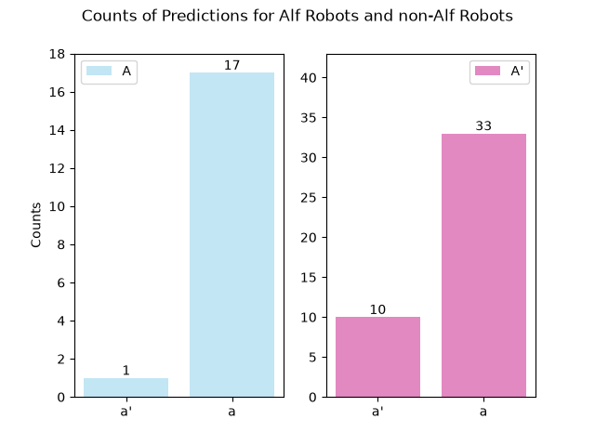
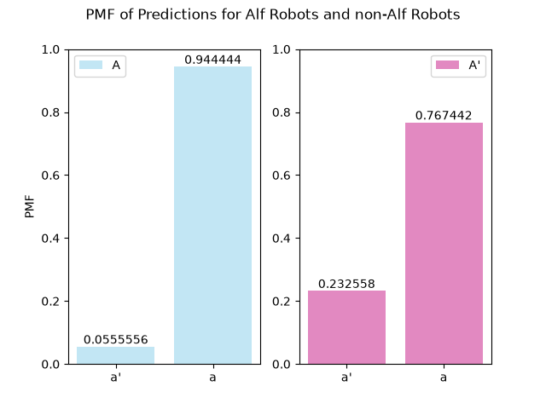
Later we will consider Data Distribution, not single outcome
Bayes’ Theorem P(A|a) = P(a|A) P(A) / P(a) → P(A | data) = L(data | A) π(A) / P(data)
These data are binary : a or a’. Described by Bernoulli PMF for a given Truth Label.

Slide 56
Focus: Hypothesis Tests
Designing a test
Terminology : So. Many. Words (and acronyms)
What a p value is and is not

Slide 57
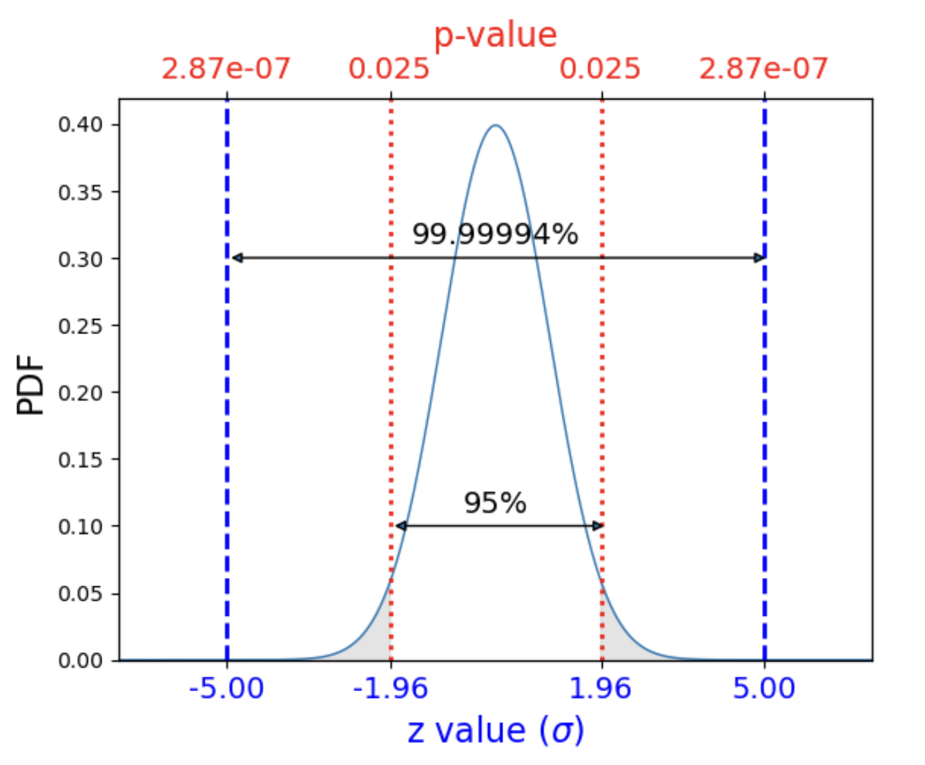
Z values
z²
z: “standard normal RV”, centered on zero
Deviation from mean x-𝜇 = z𝝈
z value of 1.96 corresponds to x value of 1.96𝝈 above the mean.

Slide 58
Confidence Intervals
68.3% of a Normal PDF lies within the “1 sigma” confidence interval.
What this means:
If I ran 1000 repeated experiments, I would expect to measure my data
inside this interval in 683 of them.
What this does not mean:
In a single experiment I have a 68.3% chance of measuring the data in this region.
Frequentist Confidence Intervals ONLY tells us about the long-run
over many repeated experiments.
We will see later that the (Bayesian) Credible Interval gives us the much more intuitive “chance of measuring the data in this region” interval.

Slide 59
P values
z²
The z value is the “inside probability” in units of 𝝈.
The p value is the corresponding “outside probability” as a fraction of 1.
Observation of data with a large z value (small p value) is rare (expected to occur with low frequency over a large number of experiments*).
*if the null hypothesis is the underlying truth!

Slide 60
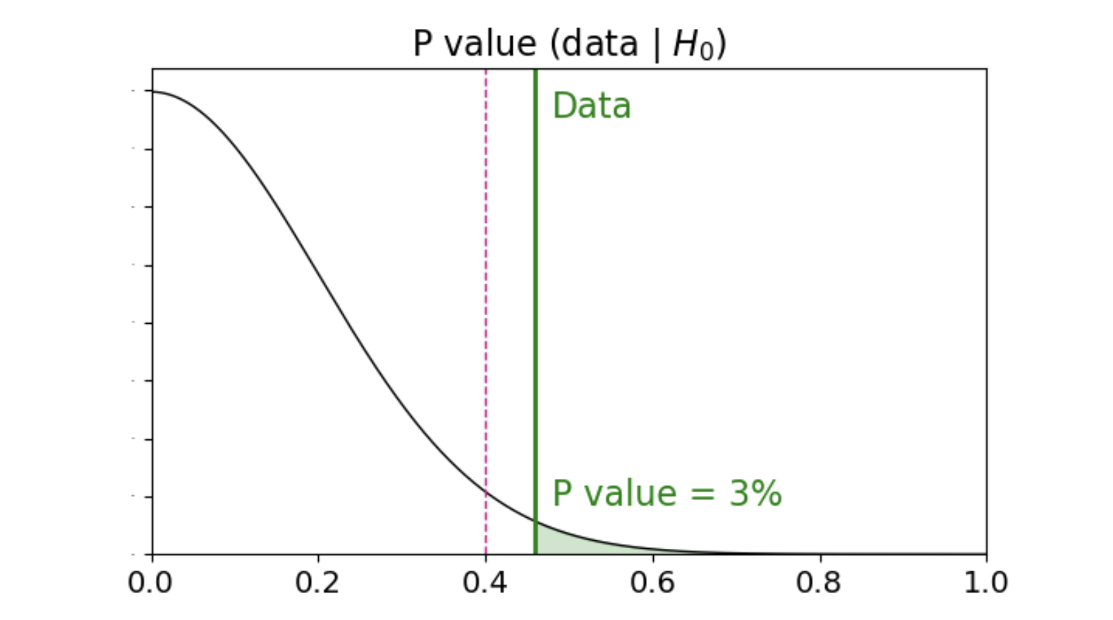
P values
We measure our statistic in the data, eg the output of a classifier
We see where that intersects the Null Hypothesis distribution, which may or may not be the correct underlying distribution
If the area under intersection (p value) is smaller than our predefined significance level α, the Null Hypothesis is rejected (a positive result).

Slide 61
Read the module notes!
Lectures only pull out a few key things that I happen to think are either interesting or easily misunderstood.
The module notes are where my thoughtful time goes.
Working through 5 Hypothesis Tests and 6 Normal Tests before next Monday will set you up nicely for the second assessed coursework, which will be released next week.
There is very little “lecture fodder” in Normal Tests, other than the SEM (Standard Error on the Mean).
I’d better get on with Part 2 of the notes, sharpish!

Slide 62
Thanks for your time
Fin

